Slide 1
Selenium

Slide 2
Continuous Testing
Continuous Testing in DevOps is a software testing type that involves testing the software at every stage of the software development life cycle. The goal of Continuous testing is evaluating the quality of software at every step of the Continuous Delivery Process by testing early and testing often.
The Continuous Testing process in DevOps involves stakeholders like Developer, DevOps, QA and Operational system.

Slide 3
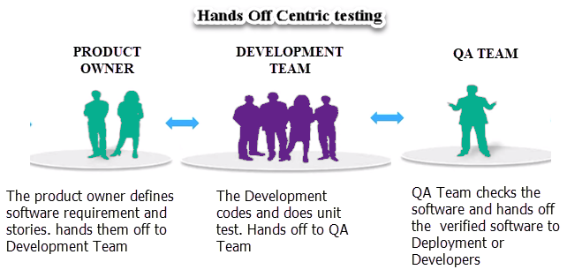
How is Continuous Testing different?
The old way of testing was hand off centric. The software was handed off from one team to another. A project would have definite Development and QA phases. QA teams always wanted more time to ensure quality. The goal was that the quality should prevail over project schedule.
However, business wants faster delivery of software to the end user. The newer is the software, the better it can be marketed and increase revenue potential of the company. Hence, a new way of testing was evolved.
Continuous means undisrupted testing done on a continuous basis. In a Continuous DevOps process, a software change (release candidate) is continuously moving from Development to Testing to Deployment.

Slide 4
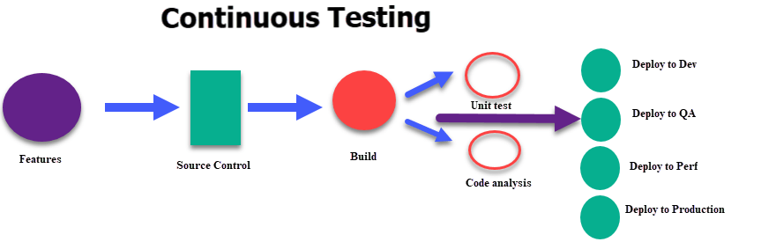
The code is continuously developed, delivered, tested and deployed.
For Example, whenever a developer checks the code in the Source Code Server like Jenkins automated set of unit tests are executed in the continuous process. If the tests fail, the build is rejected, and the developer is notified. If the build passes the test, it is deployed to performance, QA servers for exhaustive functional and load tests. The tests are run in parallel. If the tests pass, the software is deployed in production.
Continuous Testing is a small cog in the Continuous Development, Integration and Deployment Cycle.

Slide 5
Benefits of Continuous Testing
Accelerate software delivery
Continuous testing improves code quality
It helps to assess exact business risk coverage.
It seamlessly integrates into DevOps Process
Helps to create an agile and reliable process in just hours instead of months.
Accelerates time-to-market with a continuous feedback mechanism.
Merges traditionally siloed teams to meet modern enterprise needs. Dissolves disconnect between development, testing, and operations teams.
Test Automation helps to achieve consistency by maintaining the same configuration for all relevant tests.
Emphasizes business expectations to mitigate business risks
Providing ubiquitous test environment access with Service Virtualization

Slide 6
Selenium
Selenium is not just one tool or API but it composes many tools.
WebDriver
If you are beginning with desktop website or mobile website test automation, then you are going to be using WebDriver APIs. WebDriver uses browser automation APIs provided by browser vendors to control the browser and run tests. This is as if a real user is operating the browser. Since WebDriver does not require its API to be compiled with application code; It is not intrusive. Hence, you are testing the same application which you push live.
IDE
IDE (Integrated Development Environment) is the tool you use to develop your Selenium test cases. It’s an easy-to-use Chrome and Firefox extension and is generally the most efficient way to develop test cases. It records the users’ actions in the browser for you, using existing Selenium commands, with parameters defined by the context of that element. This is not only a time-saver but also an excellent way of learning Selenium script syntax.
Grid
Selenium Grid allows you to run test cases in different machines across different platforms. The control of triggering the test cases is on the local end, and when the test cases are triggered, they are automatically executed by the remote end.
After the development of the WebDriver tests, you may face the need to run your tests on multiple browsers and operating system combinations. This is where Grid comes into the picture.

Slide 7
Create test cases in Selenium
There are following steps to configure Selenium using Python:
Download and install Python on Windows.
Install Selenium libraries in Python.
Download and install PyCharm.
Create a new project and write the Selenium test script.
Run and validate the test scripts.

Slide 8
Writing a test case using Selenium
To write the first test case, consider a sample business requirement – Ensure secure user entry to abc Account.
Given that a user trying to gain entry to abc Account could either be a new or an existing user, test scenarios can be framed around both the Register and Login pages.
On viewing encounter the abc Login page, ask the following questions:
Can a user login with the correct user ID and password?
What happens when an invalid email id and invalid password are entered into the form?
What happens when a valid email id and invalid password are entered into the form?
What happens when an invalid email id and valid password are entered into the form?
All of these test scenarios can now be expanded into a set of positive and negative test cases.

Slide 9
Example of a Test Case in Selenium
Let’s build a Selenium test case example based on the first test scenario.
Test Scenario: To authenticate a successful user login on abc.com
Test Steps:
The user navigates to the abc sign-in page.
In the ’email’ field, the user enters their registered email address.
The user enters the registered password.
The user clicks ‘Sign Me In.’
Prerequisites: A registered email ID with a unique username and password.
Browser: Chrome v 86.
Test Data: Legitimate username and password.
Expected/Intended Results: Once username and password are entered, the web page redirects to the user’s dashboard.
Actual Results: As Expected
Test Status: Pass/Fail: Pass

Slide 10
Integrate Selenium with Jenkins
Step #1:
Download Jenkins from the official website of Jenkins – Jenkins. Download the latest .war file. Jenkins can be started via the command line or can run in a web application server.
Refer to the below steps for the execution through the command line:
1) Open the command prompt and type java –jar and enter the path of a .war file
2) Press enter and check if your Jenkins.war file started to run and check the status information on the command prompt console.
It should show – Jenkins is fully up and running
3) Now check whether your Jenkins is ready to use; by default, it uses port 8080.
Type “http://localhost:8080” in the browser and press enter. It will show you Jenkins UI.
Step #2:
To use Selenium with Jenkins you need to configure Jenkins with Selenium.
Follow the below steps:
Go to Jenkins dashboard
Click on manage Jenkins
Click on configure Jenkins
Click on JDK installation – In JDK name section enter the name, under Java Home section – give your java path
The radio button, Install automatically is checked by default. You need to uncheck it because it will automatically update with the new Java version and there might be a possibility that Selenium doesn’t support the new Java version. It is better to uncheck it. Now click on apply and save.
Your Jenkins is configured with Selenium and is now ready to be used with Selenium. Both Jenkins and Selenium code is written in Java. Hence, if you give the Java path then internally it will communicate and process your job.

Slide 11
package session_2;
import org.openqa.selenium.WebDriver;
import org.openqa.selenium.firefox.FirefoxDriver;
import org.testng.Assert;
import org.testng.annotations.Test;
public class jenkins_demo
{
@Test
publicvoidtestgooglrsearch(){
WebDriver driver = newFirefoxDriver();
//it will open the goggle page
driver.get("http://google.in");
//we expect the title “Google “ should be present
String Expectedtitle = "Google";
//it will fetch the actual title
String Actualtitle = driver.getTitle();
System.out.println("Before Assetion " + Expectedtitle + Actualtitle);
//it will compare actual title and expected title
Assert.assertEquals(Actualtitle, Expectedtitle);
//print out the result
System.out.println("After Assertion " + Expectedtitle + Actualtitle + " Title matched ");
}
}
Step #3:
Now, create a Selenium script and a TestNG XML file. This TestNG XML file will be required for creating a batch file and we will use that batch file in Jenkins. Refer below TestNG code:

Slide 12
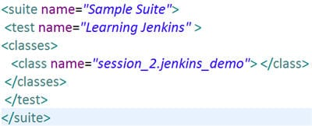
Create a TestNG xml file, refer below code:

Slide 13
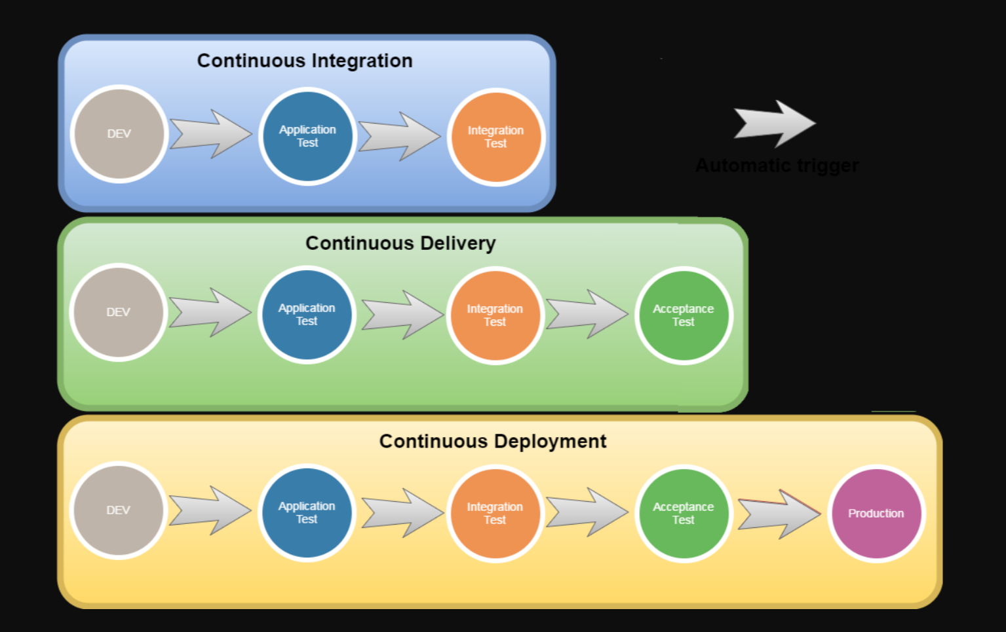
What is Continuous Deployment?
Continuous deployment is a strategy in software development where code changes to an application are released automatically into the production environment.
This automation is driven by a series of predefined tests. Once new updates pass those tests, the system pushes the updates directly to the software's users.
One of the main benefits of continuous deployment is that there is no time lag between when a code change passes application- and platform-level testing and when it moves into live production.

Slide 14
Continuous deployment tools
Continuous deployment pipelines use similar tools to those in continuous delivery, with an enhanced emphasis on code testing prior to and after deployment into production.
During development, version control and build automation, along with specialized tools, such as the project management software Apache Maven, ensure smooth delivery of code using continuous integration pipeline software, such as Jenkins.
Unit tests and functional tests put code into as many execution scenarios as possible to predict its behavior in production. Unit testing frameworks include NUnit, TestNG and RSpec, among many others.
For continuous deployment, IT automation and configuration management tools, such as Puppet and Ansible, handle code deployment and hosting resource configuration. Integration and acceptance tests can be set up in tools such as Cucumber and Calabash.

Slide 15
Puppet - Installation and Setup
Puppet is a configuration management tool that simplifies system administration. Puppet uses a client/server model in which your managed nodes, running a process called the Puppet agent, talk to and pull down configuration profiles from a Puppet master.
Puppet deployments can range from small groups of servers up to enterprise-level operations.

Slide 16
To get started using Puppet, you must first complete the initial installation and setup process.
Puppet is distributed in several packages.
These include puppetserver, puppet-agent and puppetdb. Puppet Server controls the configuration information for one or more managed agent nodes. PuppetDB is where the data generated by Puppet is stored.

Slide 17
Enabling the Puppet platform repository
Enabling the Puppet platform repository makes the components needed for installation available on your system. The process for enabling the repository depends on your package management system, such as Yum or Apt.

Slide 18
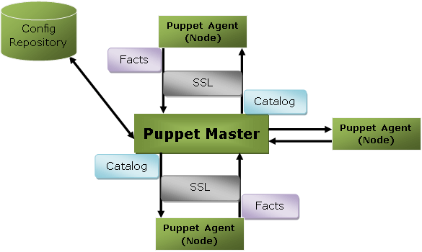
Puppet Architecture
Puppet uses master-slave or client-server architecture. Puppet client and server interconnected by SSL, which is a secure socket layer. It is a model-driven system.
the client is referred to as a Puppet agent/slave/node, and the server is referred to as a Puppet master.

Slide 19
Puppet Components
Puppet Master
Puppet master handles all the configuration related process in the form of puppet codes. It is a Linux based system in which puppet master software is installed. The puppet master must be in Linux. It uses the puppet agent to apply the configuration to nodes.
This is the place where SSL certificates are checked and marked.
Puppet Slave or Agent
Puppet agents are the real working systems and used by the Client. It is installed on the client machine and maintained and managed by the puppet master. They have a puppet agent service running inside them.
The agent machine can be configured on any operating system such as Windows, Linux, Solaris, or Mac OS.
Config Repository
Config repository is the storage area where all the servers and nodes related configurations are stored, and we can pull these configurations as per requirements.

Slide 20
Facts
Facts are the key-value data pair. It contains information about the node or the master machine. It represents a puppet client states such as operating system, network interface, IP address, uptime, and whether the client machine is virtual or not.
These facts are used for determining the present state of any agent. Changes on any target machine are made based on facts. Puppet's facts are predefined and customized.
Catalog
The entire configuration and manifest files that are written in Puppet are changed into a compiled format. This compiled format is known as a catalog, and then we can apply this catalog to the target machine.

Slide 21
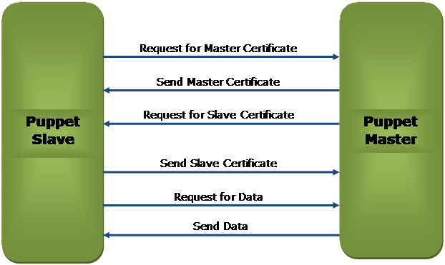
Puppet Master-Slave Communication
Puppet master-slave communicates via a secure encrypted channel through the SSL (Secure Socket Layer).
Working
Puppet slave requests for Puppet Master Certificate.
Puppet master sends the Master Certificate to the puppet slave in response to the client request.
Puppet master requests to the Puppet slave for the slave certificate.
Puppet slave sends the requested slave certificate to the puppet master.
Puppet slave sends a request for data to the puppet master.
Finally, the master sends the data to the puppet slave as per the request.

